Slide 1
Mock Election TMS 2012
Statistics Class
Justin H, Rodrigo M, Ricardo R
and Fred

Slide 2
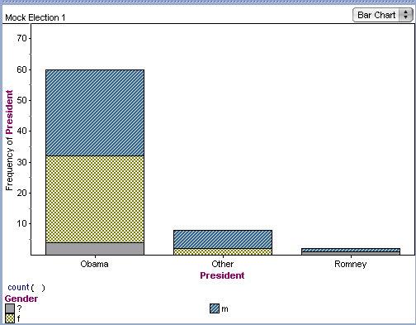
Presidential Election gender: m/f/?

Slide 3
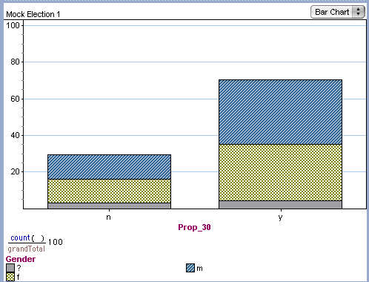
Prop 30: Temporary Taxes to Fund Education Gender: m/f/?

Slide 4
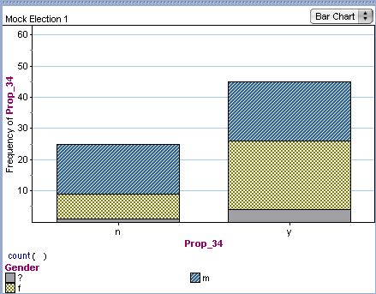
Prop 34: Death Penalty Gender: m/f/?

Slide 5
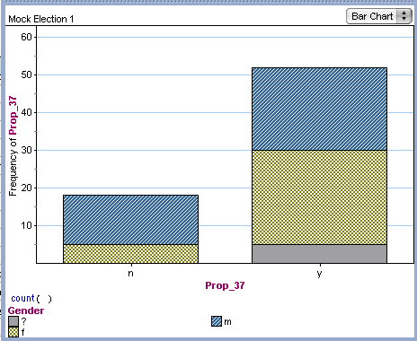
Prop 37: Genetically Engineered Food Labeling Gender: m/f/?

